Slide 1
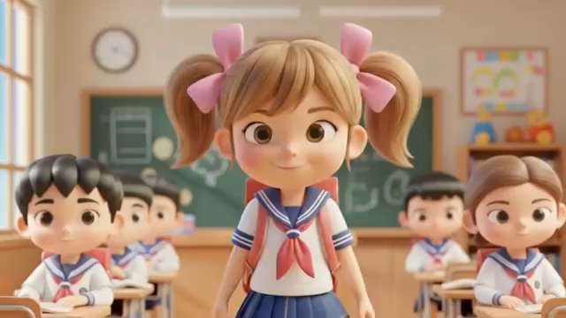

Slide 2


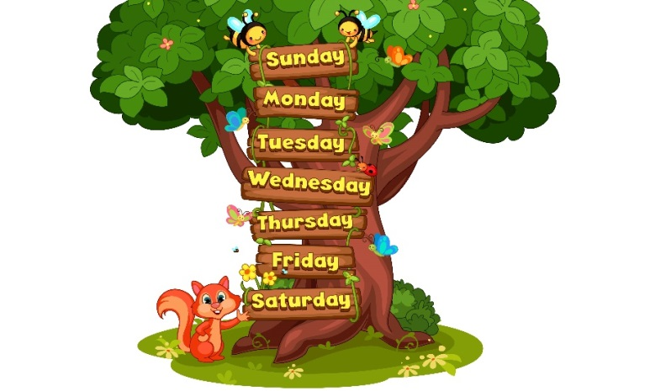

My week
3
LESSON 2 PERIOD 4
SUNDAY
SUNDAY
MONDAY
TUESDAY
WEDNESDAY
THURSDAY
FRIDAY
SATURDAY

Slide 3
Table of contents
Warm-up and review
01
04
02
03
Let’s sing.
Listen and number.
05
Fun corner
& wrap-up
Look, complete and read.

Slide 4
01
Warm-up

Slide 5

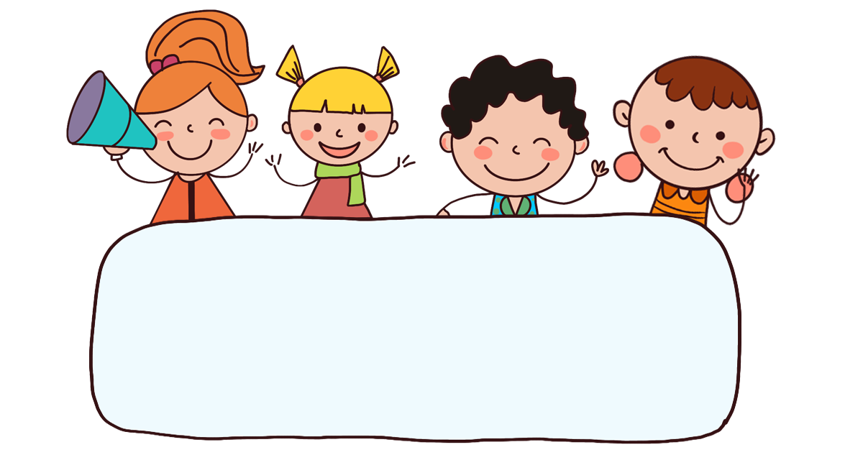
Let’s play!

Slide 7




A. listen to music
B. go to school
C. do housework

Slide 9
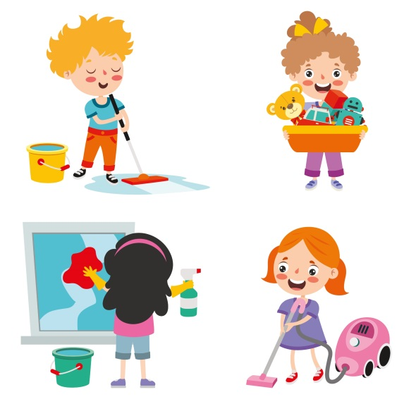
A. go to school
B. do housework
C. study at school

Slide 11

A. study at school
B. listen to music
C. go to school

Slide 13
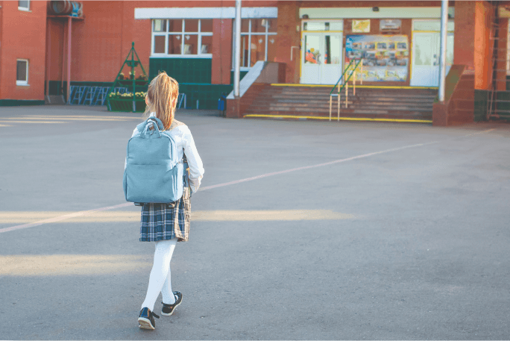
A. listen to music
B. do housework
C. go to school

Slide 15
A. listen to
B. do
______ school
C. go to

Slide 17
A. do
B. go
___ housework
C. listen

Slide 19
A. do
B. go to
____ at school
C. study

Slide 21
A. hause
B. house
do _______work
C. home

Slide 23

A. It’s Thursday.
What day is it today?
B. It’s Tuesday.
C. It’s Tuesdays.

Slide 25

A. It’s Thursday.
What day is it today?
B. It’s Sunday.
C. It’s Thursdays.

Slide 26
02
Activity 4
Listen and number.

Slide 27
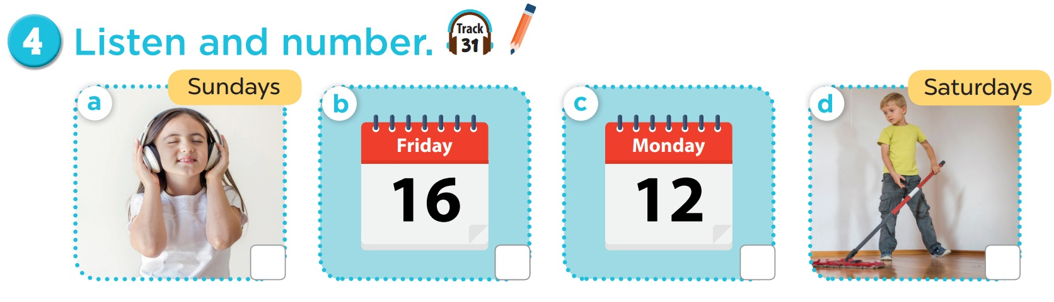
4
3
1
2

Slide 28
03
Activity 5
Look, complete and read.

Slide 29
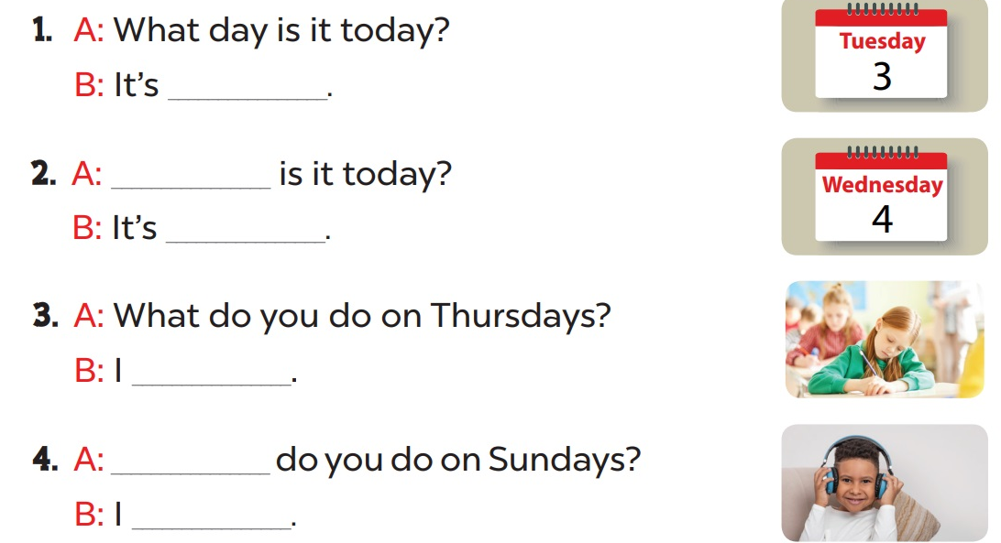
Complete and read aloud.
Tuesday
What day
Wednesday
study at school
What
listen to music

Slide 30
04
Activity 6
Let’s sing.

Slide 31

6. Let’s sing.

Slide 32
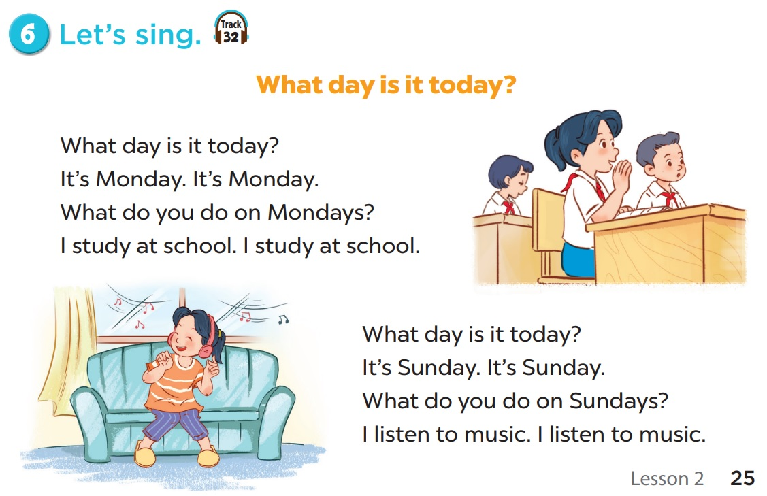
Notes:
Video hoạt hình: https://www.youtube.com/watch?v=YvH0KYru6h0&list=PL8_ETpRL2xNay3h-a-vBjWhplE1wXFpSJ&index=1

Slide 33

What day is it today?
It’s Monday. It’s Monday.
What do you do on Mondays?
I study at school. I study at school.

Slide 34

What day is it today?
It’s Sunday. It’s Sunday.
What do you do on Sundays?
I listen to music. I listen to music.

Slide 35
05
Fun corner & wrap-up

Slide 36

Bùi Liễu
Thank you!

